Slide 1
Evaluation – Setup
Different datasets:
Roman Forum ~ O(10⁵)
Berlin ~ O(10⁶)
Paris ~ O(10⁶)
London ~ O(10⁶)
World by Yahoo ~ O(10⁸)

Slide 2
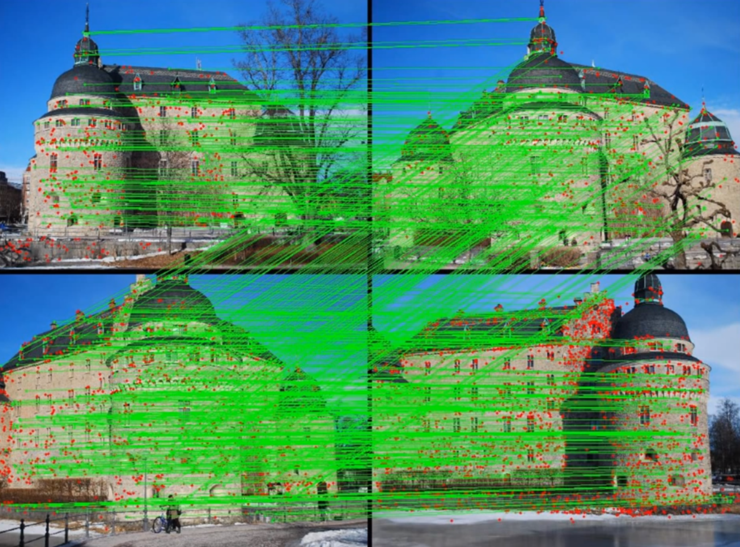
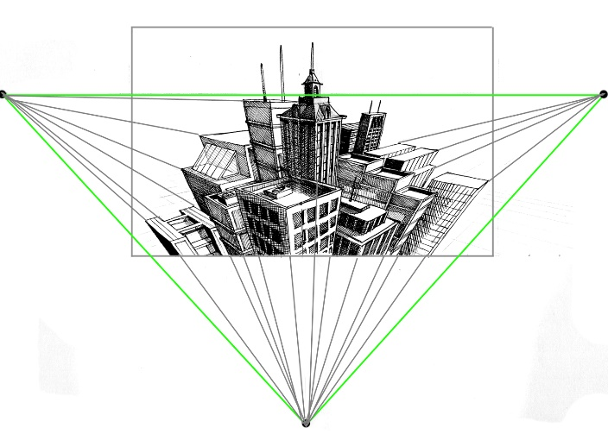
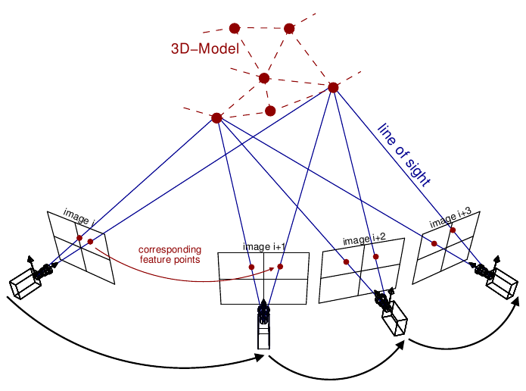
Evaluation – Setup
Different datasets:
Roman Forum ~ O(10⁵)
Berlin ~ O(10⁶)
Paris ~ O(10⁶)
London ~ O(10⁶)
World by Yahoo ~ O(10⁸)
Image match algorithm:
>= 30 inliner matches
Ignore images if > 70% of inliners are along the outer boarder (watermarks)
Positioning camera in existing 3D model requires >= 50 P3P

Slide 3
Evaluation – Benchmark → Improvements
Results & Comparison:
Roman Forum (MatchMiner)
~4.7x faster (PC vs 53-node cluster)
More images (~ +11.7%)
~1.5x better connectivity
Berlin (Frahm et al.)
~14x faster
~2x more registered photos
Berlin/London/Paris:
Registration rate of ~25%
Computation rates scale linearly
State-of-the-art model completeness
Improvements:
7 high-performance HDDs
Render down to 640x480 pixels
Use >5x memory
More powerful GPUs
Bottleneck: Harddrive too slow

Slide 4
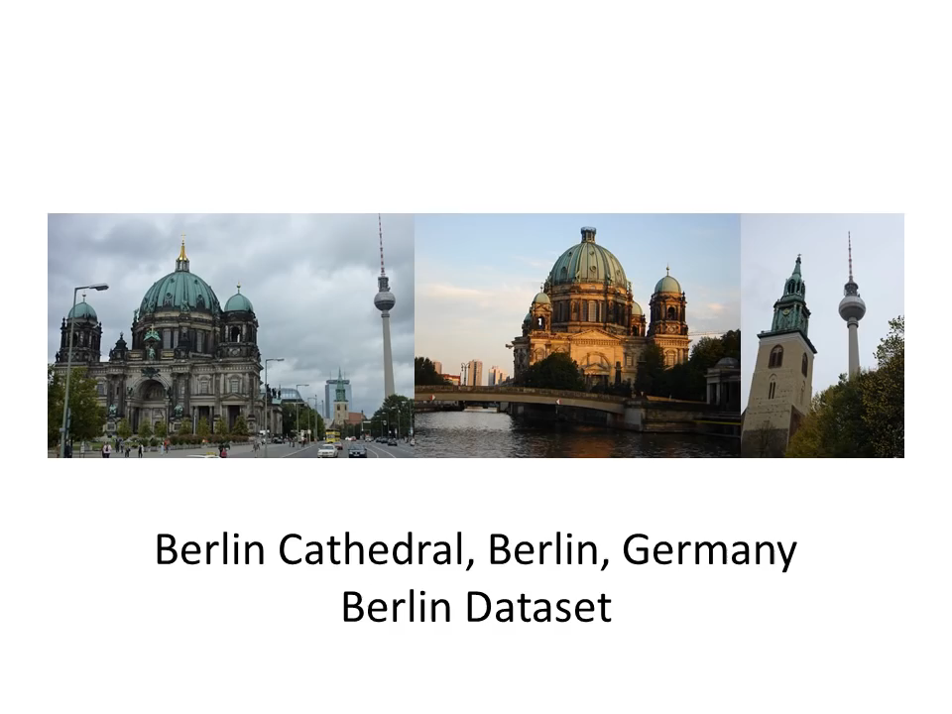
Evaluation – World Results

Slide 5
Conclusion
Achievements:
State of the art model-completeness
First to handling unordered world-scale datasets
~100 Mio images processed to 3D models within 6 days
While at the same time being
Modular
Online (streaming, on the fly)
Scalable (linear processing time)
Future research:
Streaming
Associating data (on the fly) is more difficult
Higher model completeness
New data association concepts
Critics:
Not reconstructing the world
Ignoring unmatched images after a defined period
Only matched ~1.5% of all images

Slide 6


Slide 7
Our Ideas to Reconstruct the World
Split the world in many coherent areas/datasets (e.g. cities)
Depending on image density
Geolocation
Process datasets separately
Neighbouring areas
Don’t “forget” images by running out of memory
Macro-scale: sorted
Micro-scale: unsorted

Slide 8
Open Questions
Tritratrallala

Slide 9
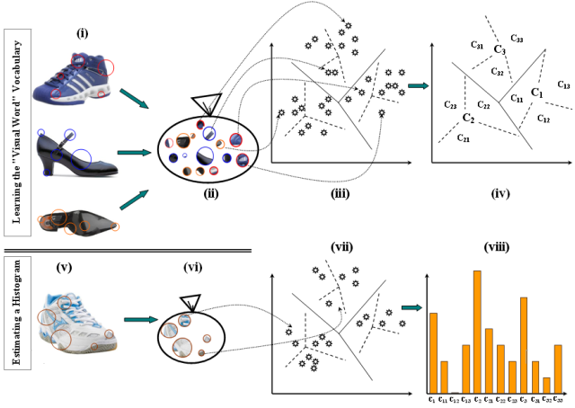
Vocabulary tree
Vocabulary tree is a compact way to do image retrieval. Vocabulary tree is something which is made by clustering visual words into clusters.

Slide 10
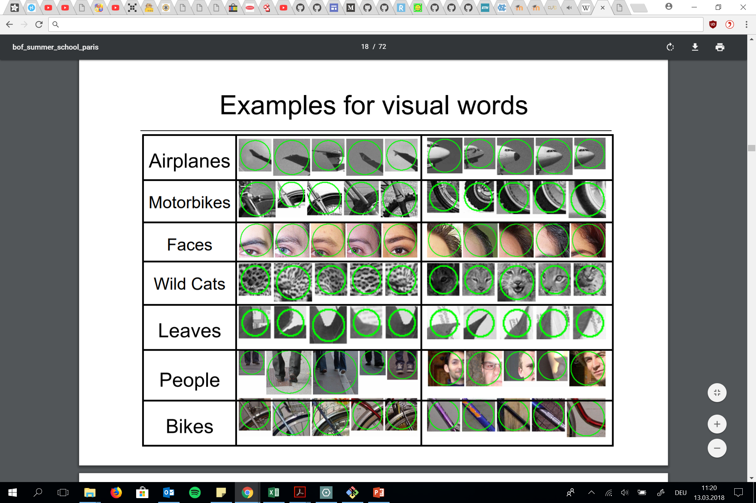
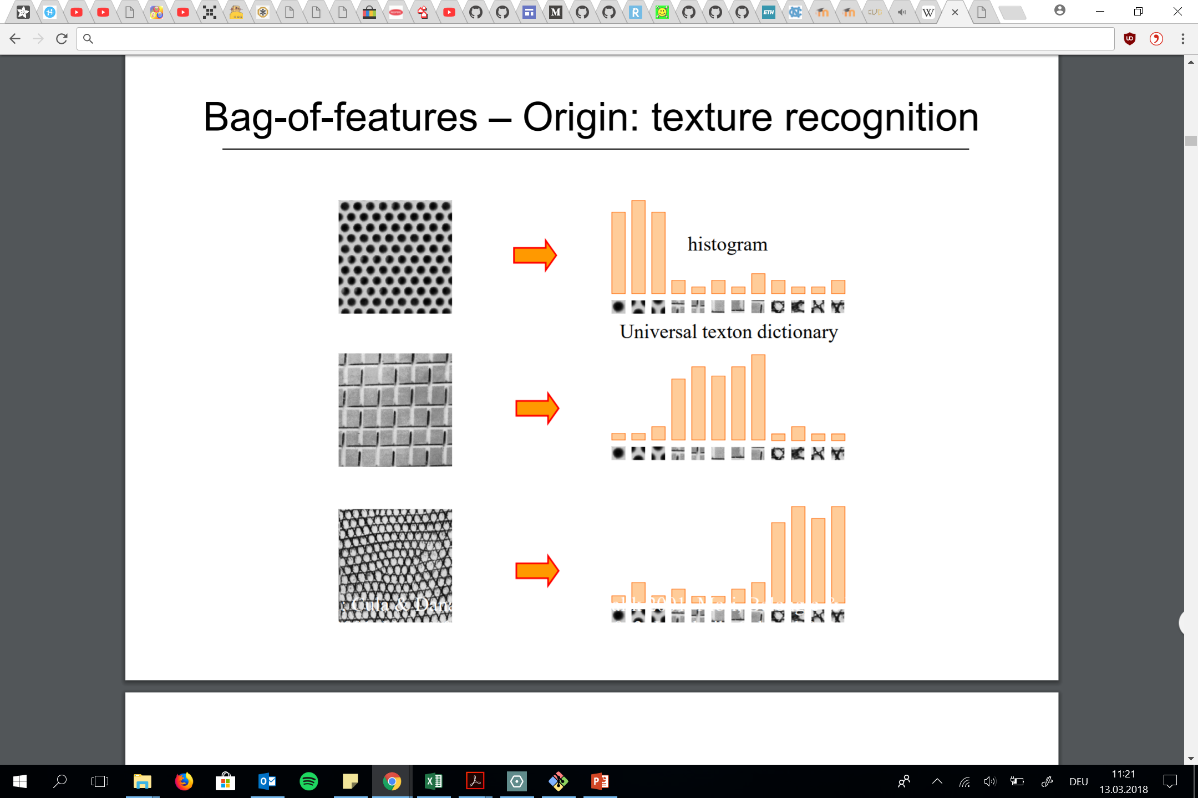
Problems
Texture is characterized by the repetition of basic elements or textons
http://www.di.ens.fr/willow/events/cvml2011/materials/CVML2011_Cordelia_bof.pdf

Slide 11
Evaluation – Benchmark → Improvements
Results & Comparison:
I/O Bottleneck: Harddrive too slow
Roman Forum (MatchMiner)
~4.7x faster (PC vs 53-node cluster)
More images (~ +11.7%)
~1.5x better connectivity
Berlin (Frahm et al.)
~2x more registered photos
~14x faster
Berlin/London/Paris:
Registration rate of ~25%
Computation rates scale linearly
State-of-the-art model completeness
Improvements:
7 high-performance HDDs
Render down to 640x480 pixels
Use >5x memory
More powerful GPUs

Slide 12
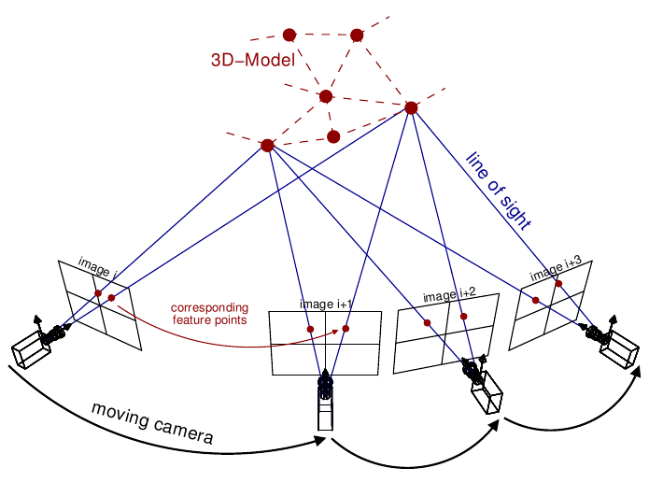
Evaluation
Split into 2 sections:
First one: Same PC as Frahm et al. [9] to check performance with the same small scale datasets
Second: Better PC: World
Different datasets:
Roman Forum
Berlin
Paris
London
World by Yahoo
Training Workflow and Diagramm of A3C high-level achitecture → Asynchronous Advantage Actor-Critic

